Slide 1
ASSIGNMENT ON CONTROL STATEMENT & ARRAY
FROM
PAVANKALYAN
TO
MENTOR
LALITHA

Slide 2
Control statements
Control statements are the statements which alter the flow of execution and provide better control to the programmer on the flow of execution
Conditional statement:Conditional statements are mostly used in decision-making scenarios which means these statements take a decision on the basis of some conditions and then executed.
simple if statement
if-else statement
Nested if statement
if-else-if statement
switch statement

Slide 3
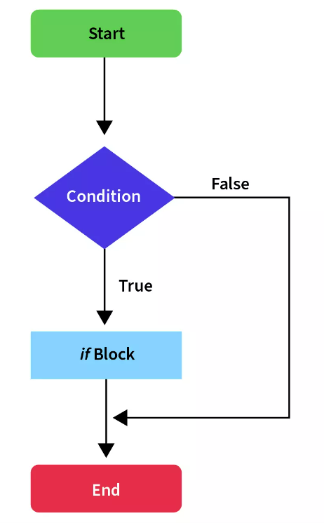
1)simple-if statement:It is one of the most simple and significant conditional
statements which will execute only if the condition is true.
Program on simple if statement
class Student {
public static void main(String[] args) {
int x = 10;
int y = 12;
if(x+y > 20) {
System.out.println("x + y is greater than 20");
}
}
}

Slide 4
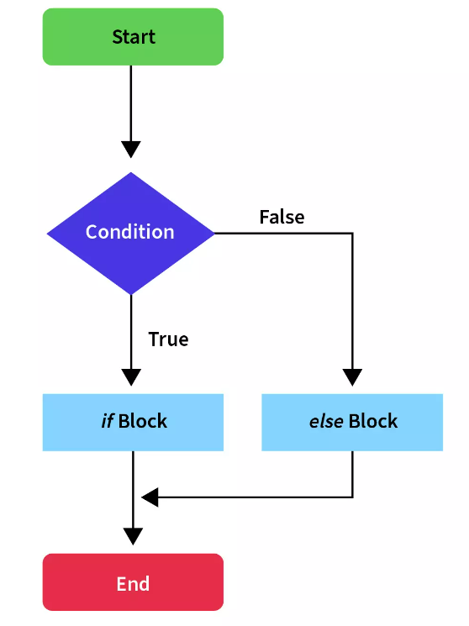
if-else statement: In this statement if condition specified is true, the if block is executed. Otherwise, the else block is executed.
write a program on if-else statement
class Student {
public static void main(String[] args) {
int x = 10;
int y = 12;
if(x+y < 10)
{
System.out.println("x + y is less than 10");
}
else {
System.out.println("x + y is greater than 20");
}
}
}
output: x+y is greather than 20

Slide 5
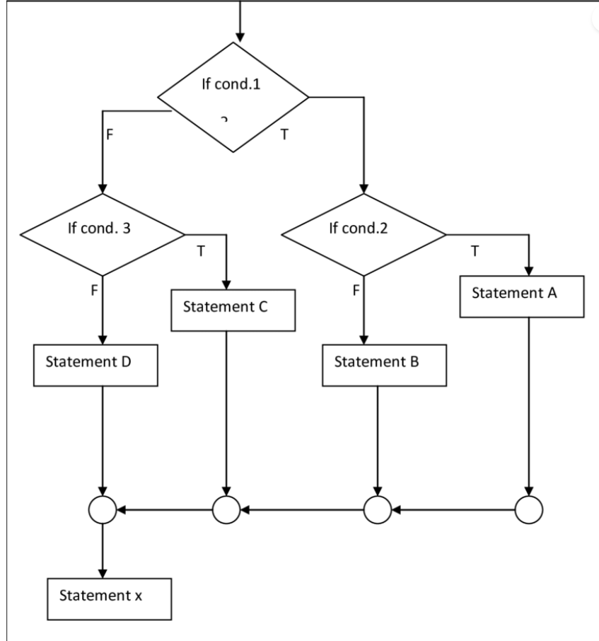
Nested if statement. An if present inside an if block is known as a nested if block.
write a program for a given number is greater
import java.util.Scanner;
class Sample {
public static void main(String args[]) {
int a=50,b=10,c=30;
if(a>b){
if(a>c){
System.out.println("a is big");
}
else
{
System.out.println("c is big");
}
}
else if(b>c){
System.out.println("b is greater");
}
}
}
output: a is greater number

Slide 6
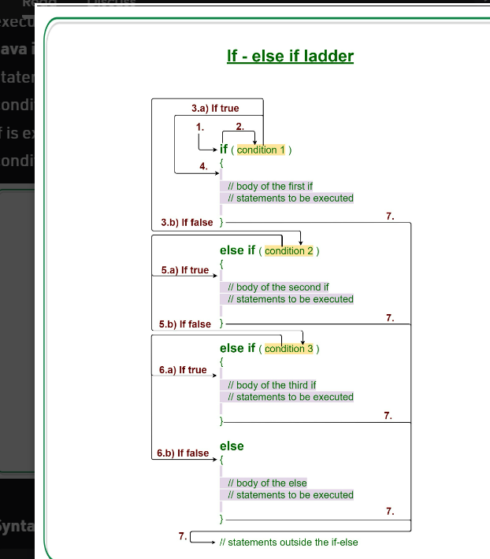
if-else-if ladder:It is used to decide among multiple options. The if statements are executed from the top down. As soon as one of the conditions controlling the if is true, the statement associated with that if is executed, and the rest of the ladder is bypassed.
write a program to calculate the number of notes
import java.util.*;
class Note{
public static void main(String args[]){
Scanner s=new Scanner(System.in);
System.out.println("Enter the amount");
int amt=s.nextInt();
if(amt%500==0){
System.out.println("number of 500 notes are "+amt/500);
}
else if (amt%200==0){
System.out.println("number of 200 notes are "+amt/200);
}
else if(amt%100==0){
System.out.println("number of 100 notes are "+amt/100);
}
else
System.out.println("invalid input");
}
}

Slide 7
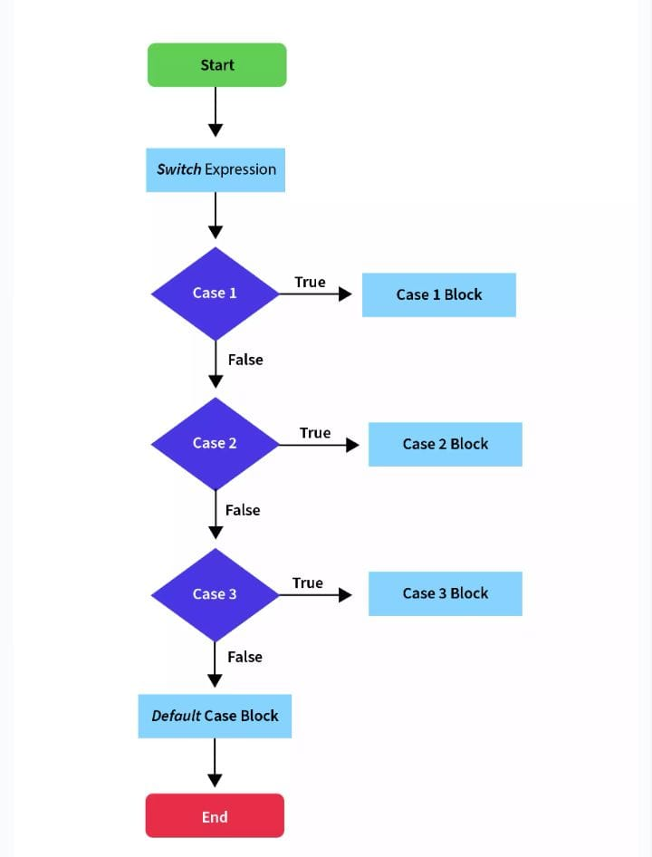
Switch statement: when there are several option we have to choose only one option from the available one we can use switch statement. Depending upon the selected option a particular task can be performed. Task consists of one or more statements
Switch fall through: if all the cases are belong to particular optional statement so we cannot use break statement between one case to another case
Int,byte,long,short,enum are accepted in switch case & Boolean,float, double are not accept

Slide 8
write a program to execute a vowels by using switch case
import java.util.Scanner;
class Sample {
public static void main(String args[]) {
Scanner sc=new Scanner(System.in);
System.out.println("Enter character");
char ch=sc.next().charAt(0);
switch(ch){
case 'A':
System.out.println("vowel");
break;
case 'E':
System.out.println("vowel");
break;
case 'I':
System.out.println("vowel");
break;

Slide 9
case 'O':
System.out.println("Vowel");
break;
case 'U':
System.out.println("vowel");
break;
default:
System.out.println("consonant");
}
}
}
Looping Statements: Statements that execute a block of code repeatedly until a specified condition is satisfies these are known as looping statements.
For loop. The for loop in java is used to iterate and evaluate a code multiple times under its condition
for loop consists of initialisation,conditional statement,decrement/Increment statement

Slide 10
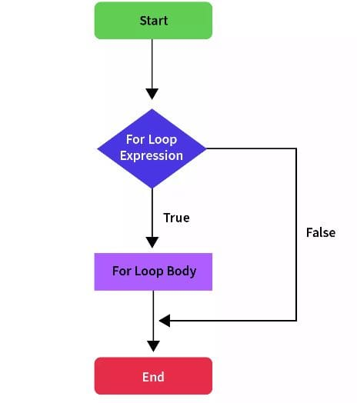
syntax
for (initialization; condition; increment/decrement)
{
// code block to be executed if condition is true
}
write a program on for loop to print 10-1 numbers
class {
public static void main(String args[]) {
for (int num = 10; num > 0; num--)
System.out.println( "The value of the number is: " + num );
}
}

Slide 11
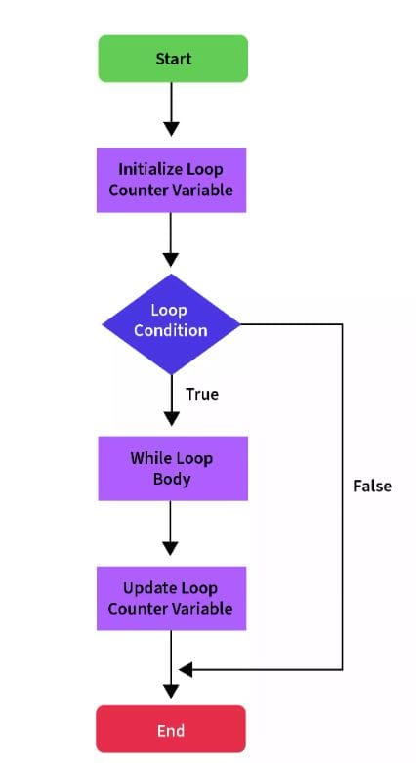
while loop
In a while loop the condition is tested first and then only statement is
executed.this means it provide better control right from the begining.
IT is more efficient than do-while loop
The while loop statement is the simplest kind of loop statement. It is used to iterate over a single statement or a block of statements until the specified
boolean condition is false.
write a program to print 1-10 for while loop
class Sample{
public static void main(String args[])
{
int i=1;
while(i<=10){
System.out.println(i);
i++;
}
}
}

Slide 12
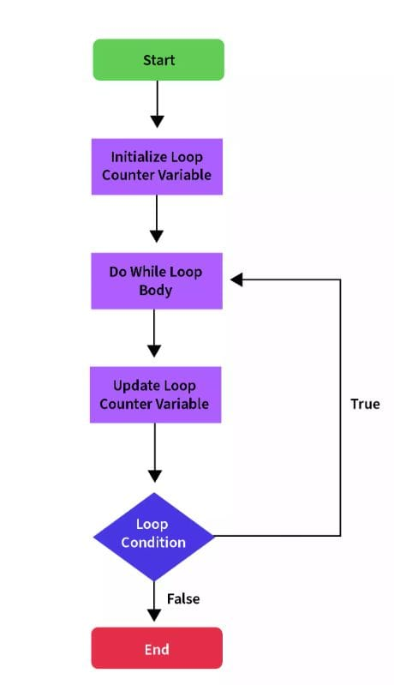
Do-while:In a do while loop the statements are executed with out testing the condition
for a first time from the second only the condition is observered .
This means the program doesn’t control the statement from the begining of execution
write a program to print 1-10 by using do while
class Sample{
public static void main(String args[])
{
int i=1;
do{
System.out.println(i);
i++;
}while(i<=10);
}
}

Slide 13
Arrays
array is a object in which we can store collection of similar data type of data
array is dynamically allocated memory that means it changes it memory size
array is a user defined & modified by user .
array is a group of variable that a reffered by a common name
we can declare a new array of a name “a” by int a[ ]=new int[ 5 ];
we can declare array size by int size=sc.nextInt[ ];
array index start with “ 0 “ and ends with “n-1”.
How to declare array,size,length ,array elements
import java.util.*;
class Sample{
public static void main(String args[])
{
Scanner sc=new Scanner(System.in);
System.out.println("enter size");
int size=sc.nextInt();
int a[ ]=new int[size];
System.out.println("enter array values");

Slide 14
for(int i=0;i<a.length;i++){//i=2
a[i]=sc.nextInt();
}
System.out.println("Array elements");
for(int i=0;i<a.length;i++){
System.out.println(a[i]);
}
}
}

Slide 15
THANK
YOU

